Slide 1

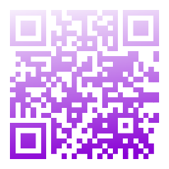




nodiam
BYTE SPARK 2024
presents
Scan the QR code to book your FREE slot now!
12th Jan, 12:00 pm
St. Xavier’s School

